Slide 1
The Erasmus+ trip
October 29th 2017 to November 11th 2017
From Zealand business college, Denmark
To West Nottingham college, England

Slide 2
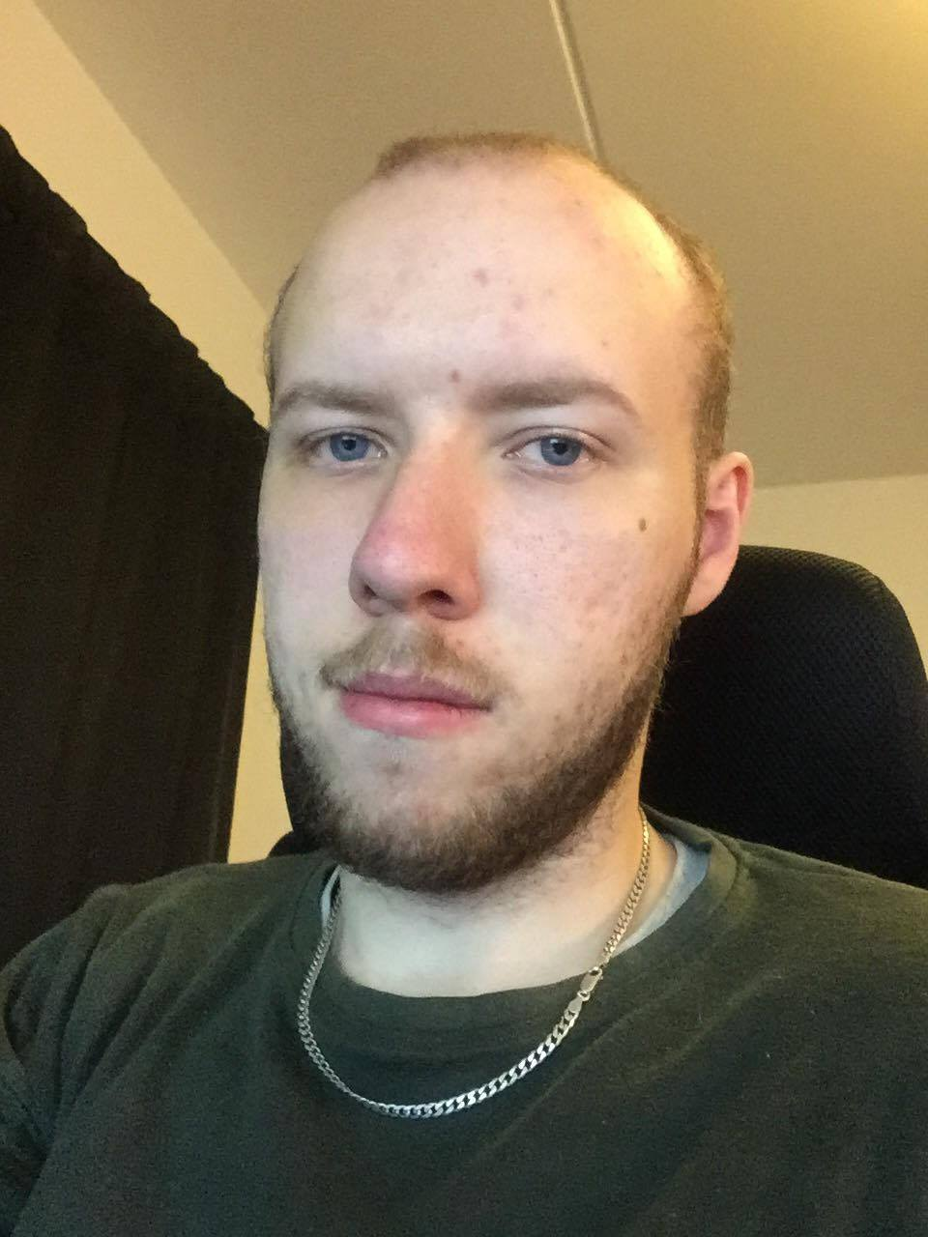
Who am I?
I am Martin Baage, I am 22 years old.
I am a Danish student in the field of computer science.

Slide 3
Why I went?
I went for the trip to learn a few things.
For the example how the British school system works.
The general prices for living and payment compared to Denmark.
To experience British values and rules in and out of classrooms.

Slide 4
What I wanted to get out of it?
Some British friends.
An experience away from Denmark and the usual school days.
Learn more about my strengths and weaknesses.
Some new IT knowledge.
Strengths and weaknesses by living abroad compared to Denmark.

Slide 5
What did I get out of it?
I got some British friends out of it.
I got a pretty good experience by going there.
I learned quite a bit where my strengths and weaknesses are.
I did not learn anything new about computers or IT systems while there.
The path that I would take benefit me the most to stay in Denmark.

Slide 6
Did I get something unexpected out of it?
I found out that I was taking my school for granted which have changed my point of view as I am more focused on my school and on my path in life.
Most of the students at West Notts were paying to go to the college which in term puts them in debt unless they have a rich family.
While in Denmark we have 3 tries to get an education, where we don’t have to pay at schools.

Slide 7
Did I enjoy the trip?
I enjoyed the trip and I am glad that Erasmus+, ZBC and West Notts College provided this opportunity as I learned quite a bit about myself in the process.

Slide 8
What were the good points?
I got a little closer to some of the students from my class that I didn’t think I would have talked to at all if not for this opportunity.
I got to try VR at West Notts College.
I experienced another part of England that I have not done.
The way we were welcomed into West Notts.

Slide 9
What were the bad points?
There was miscommunications between West Notts, ZBC and the students as we did not get all of the things that we expected.
The college Portland was not the best to live at.
I did not learn anything new about IT while I were there.

Slide 10
Where did we go while we were there?
We went to Nottingham city, Manchester stadium, an arcade club, Knowhow repair center and distribution center.

Slide 11
Did I do something outside of the schedule?
I also asked Trudi to try to VR headset that they had which were set up for a half an hour but we were there until 10 AM.
I went to a full school day at Friday 10th before we went home to Denmark to get a day’s experience of the full school day.
I did not learn anything I do not already know but I like that and Trudi let me join one of the classes for a day.

Slide 12
Conclusion
I would recommend institutions to better communicate in general and if there is changes in schedule.
More integration with the classes while there to make the experience with a class more like we always were a part of it.
More focus on what the education at home is about so classes with IT will have more about that while they are there.

Slide 13
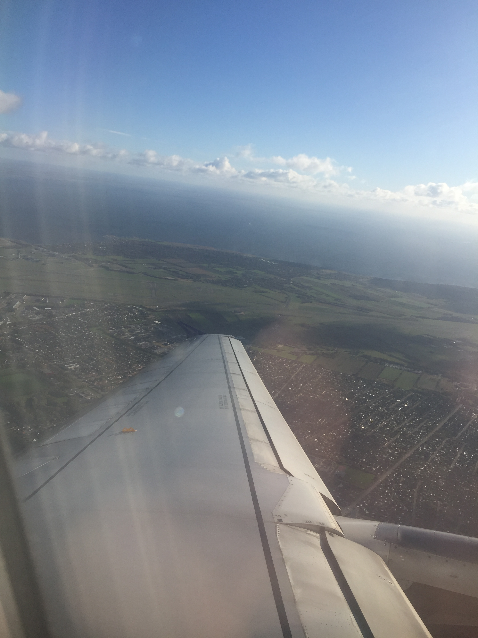
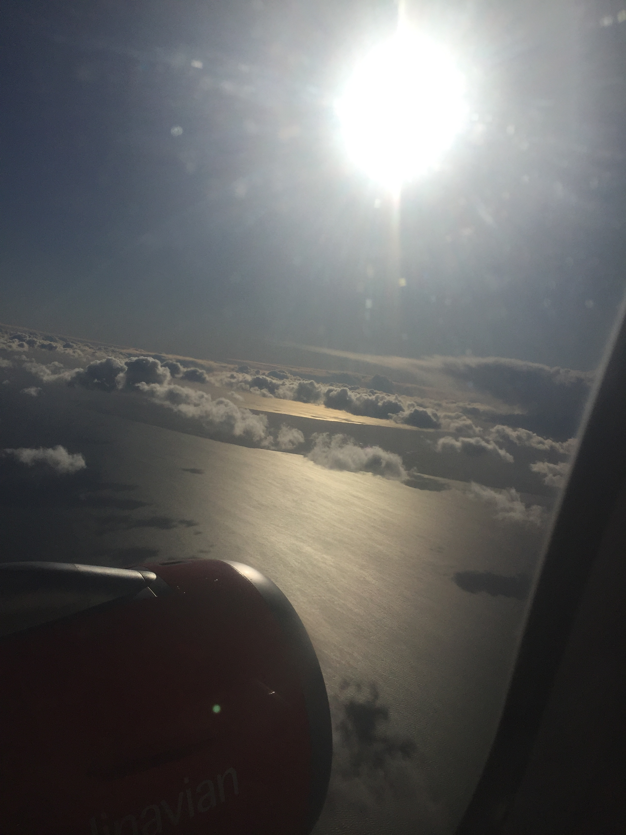
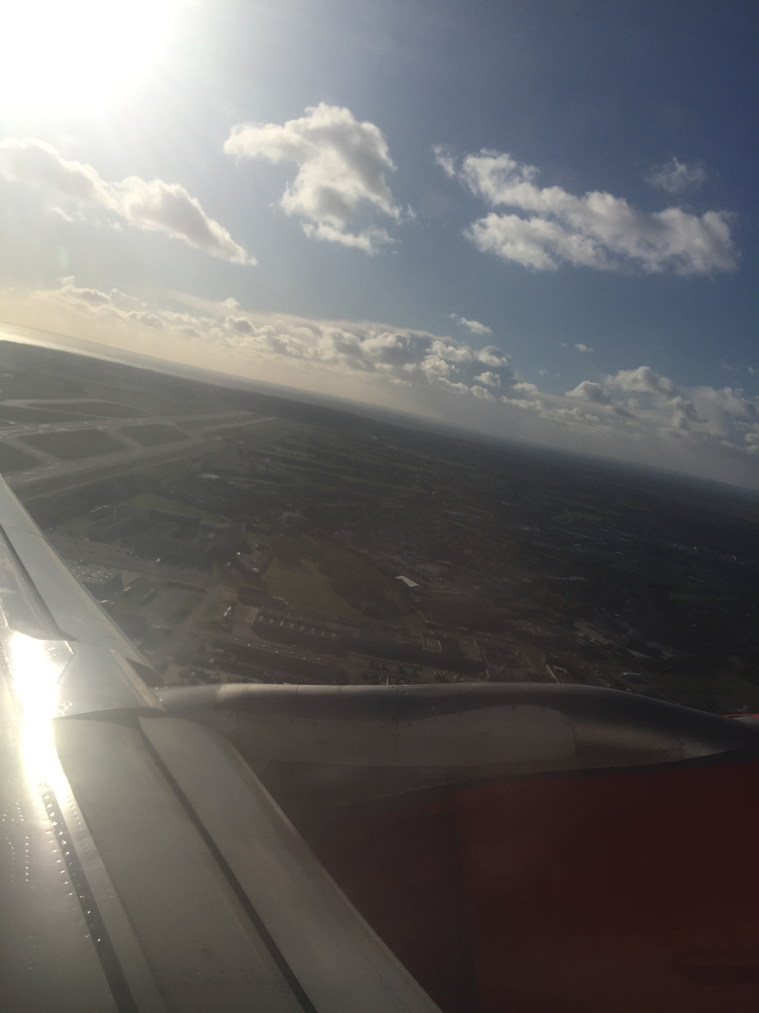
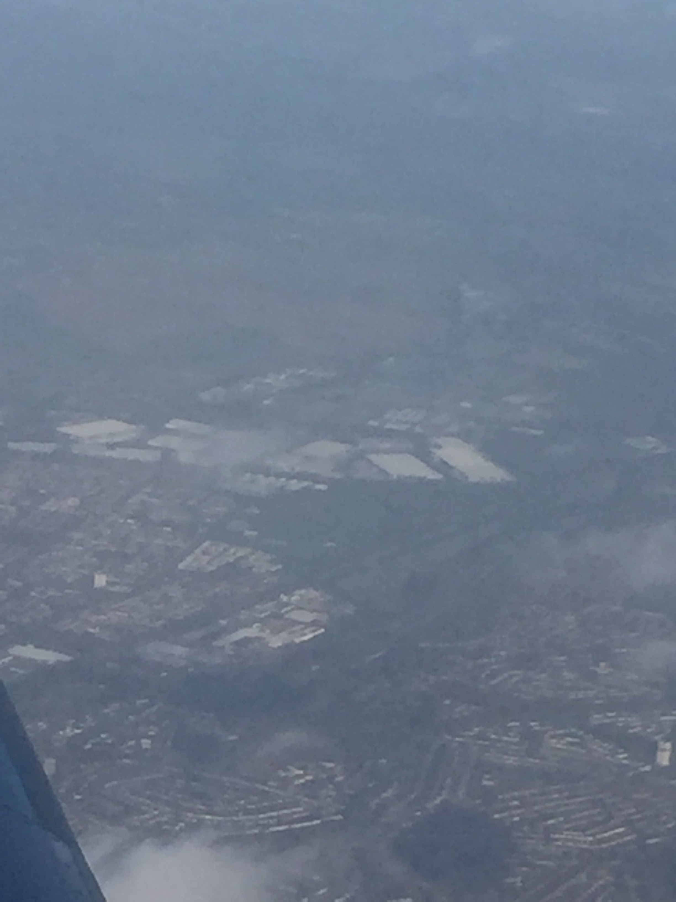
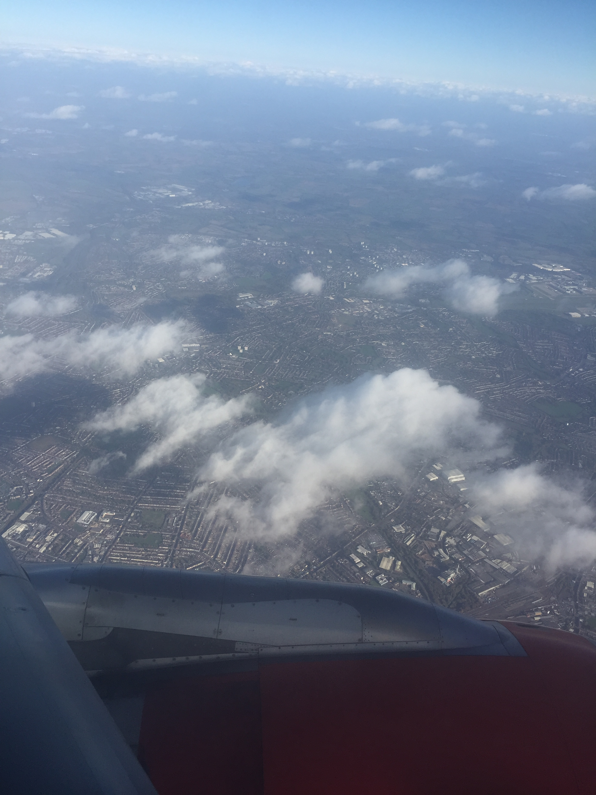
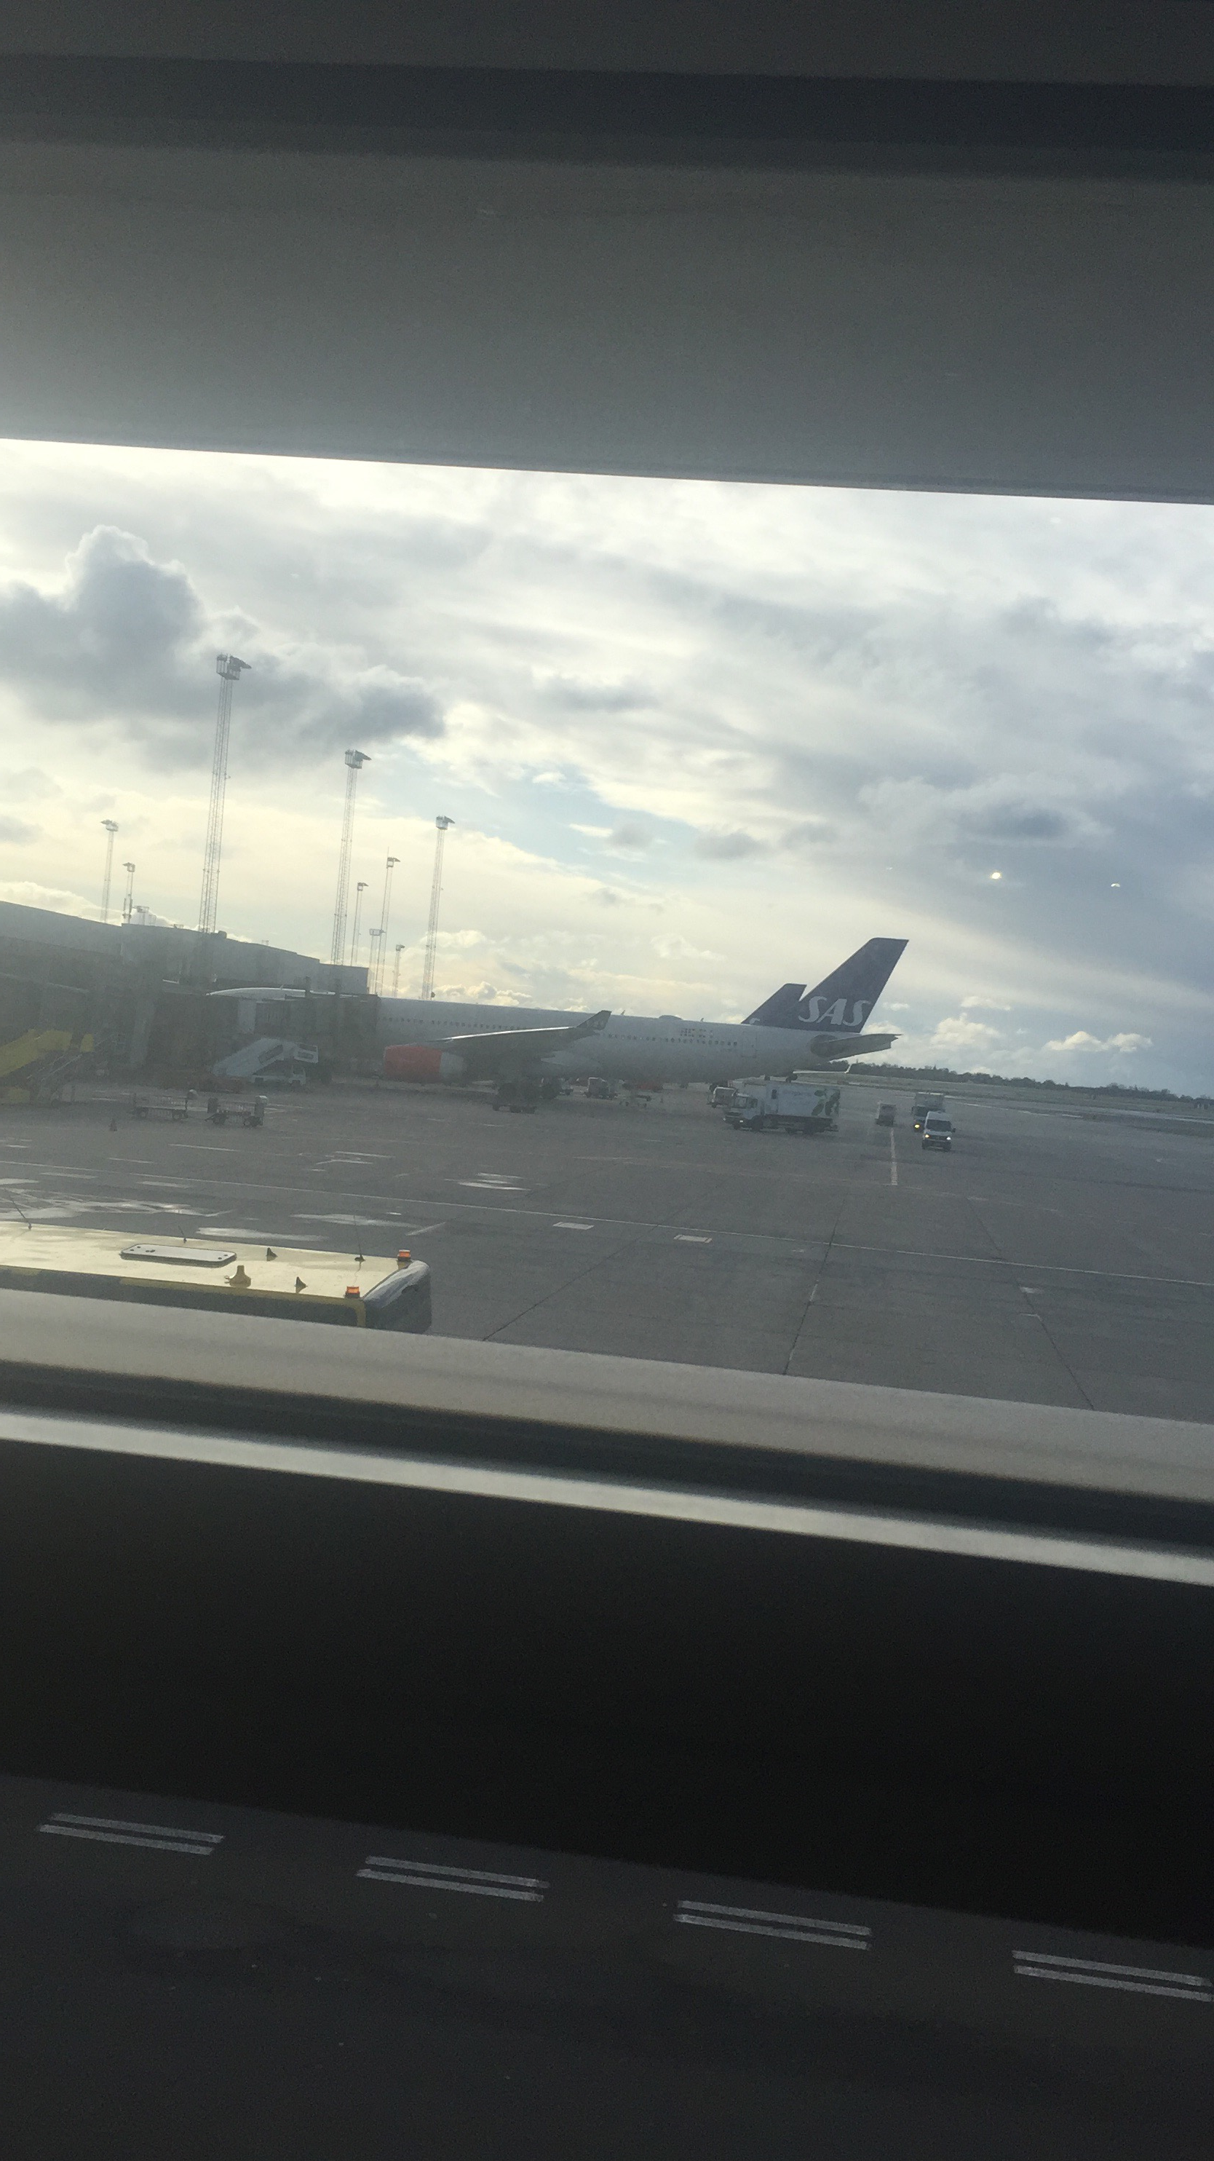
Pictures from the Flight

Slide 14
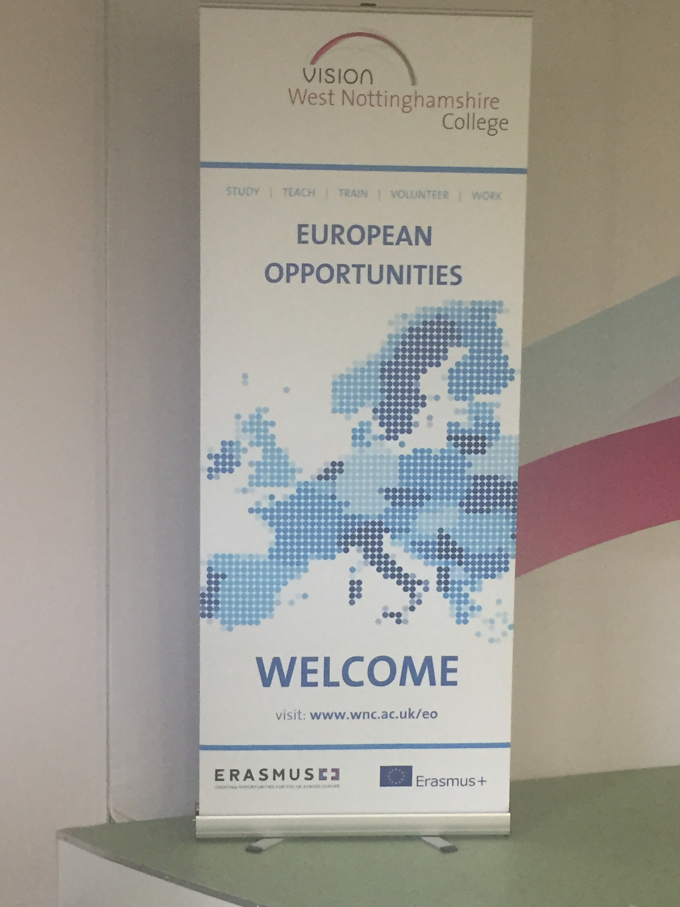
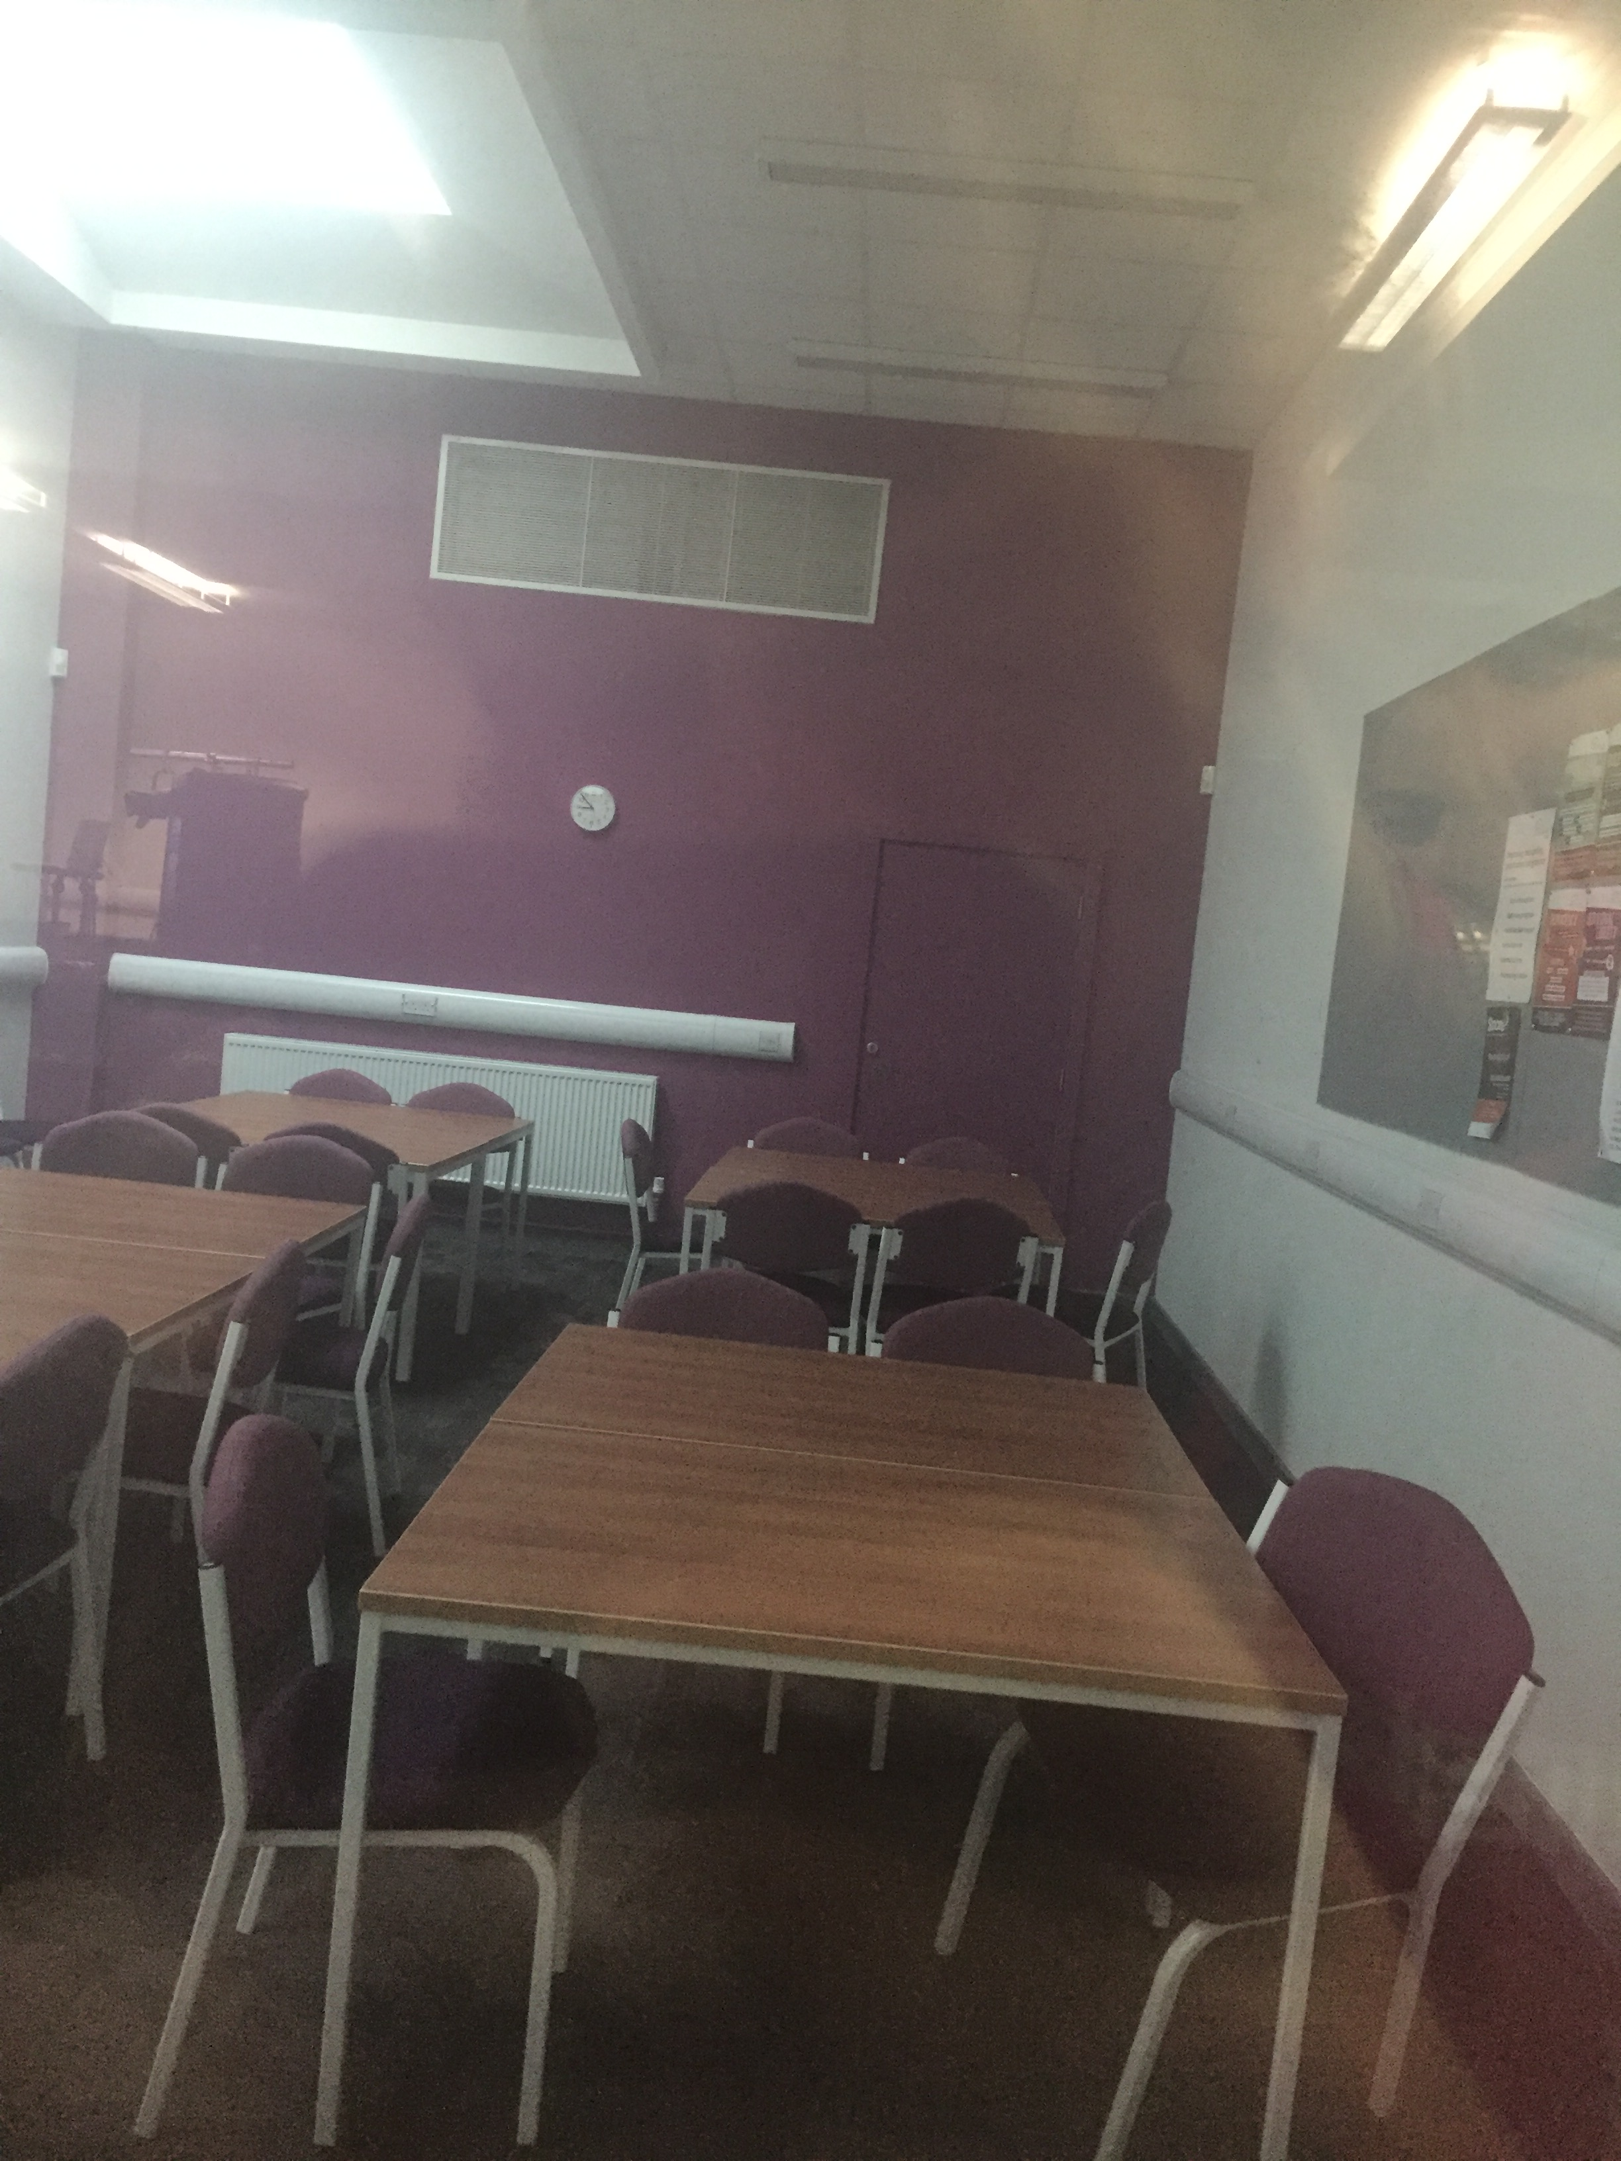
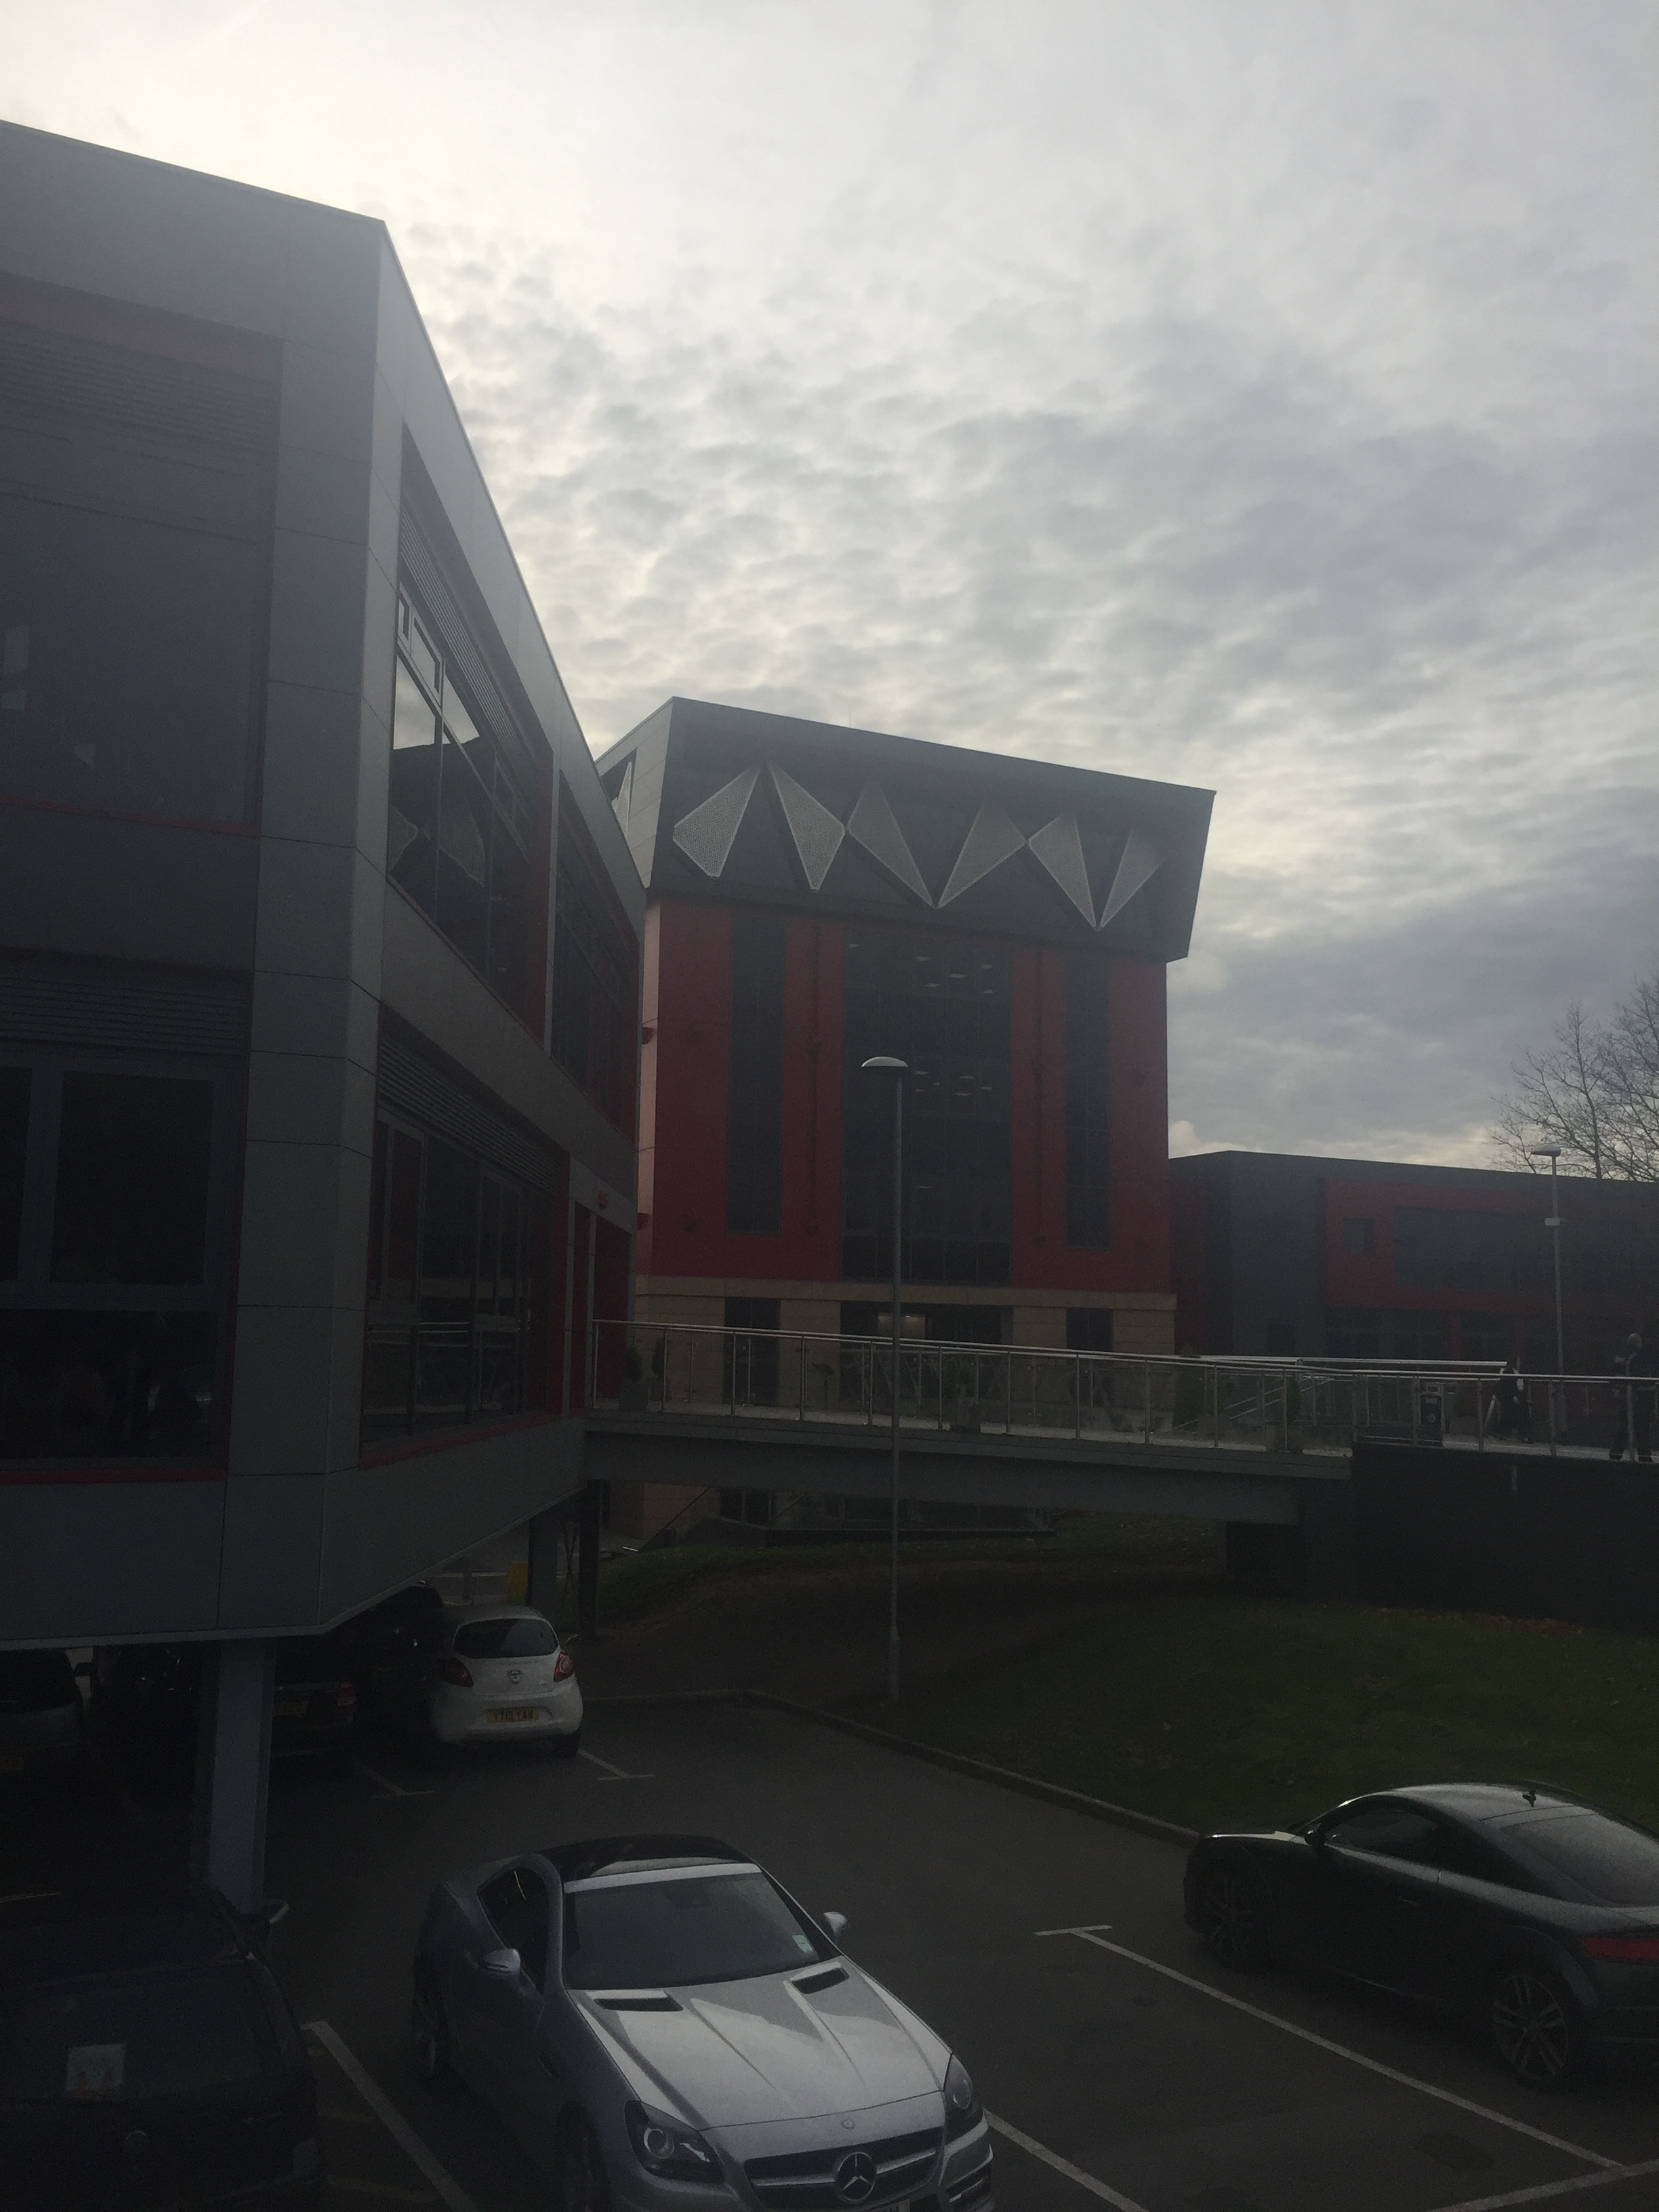
Pictures in or of West notts

Slide 15
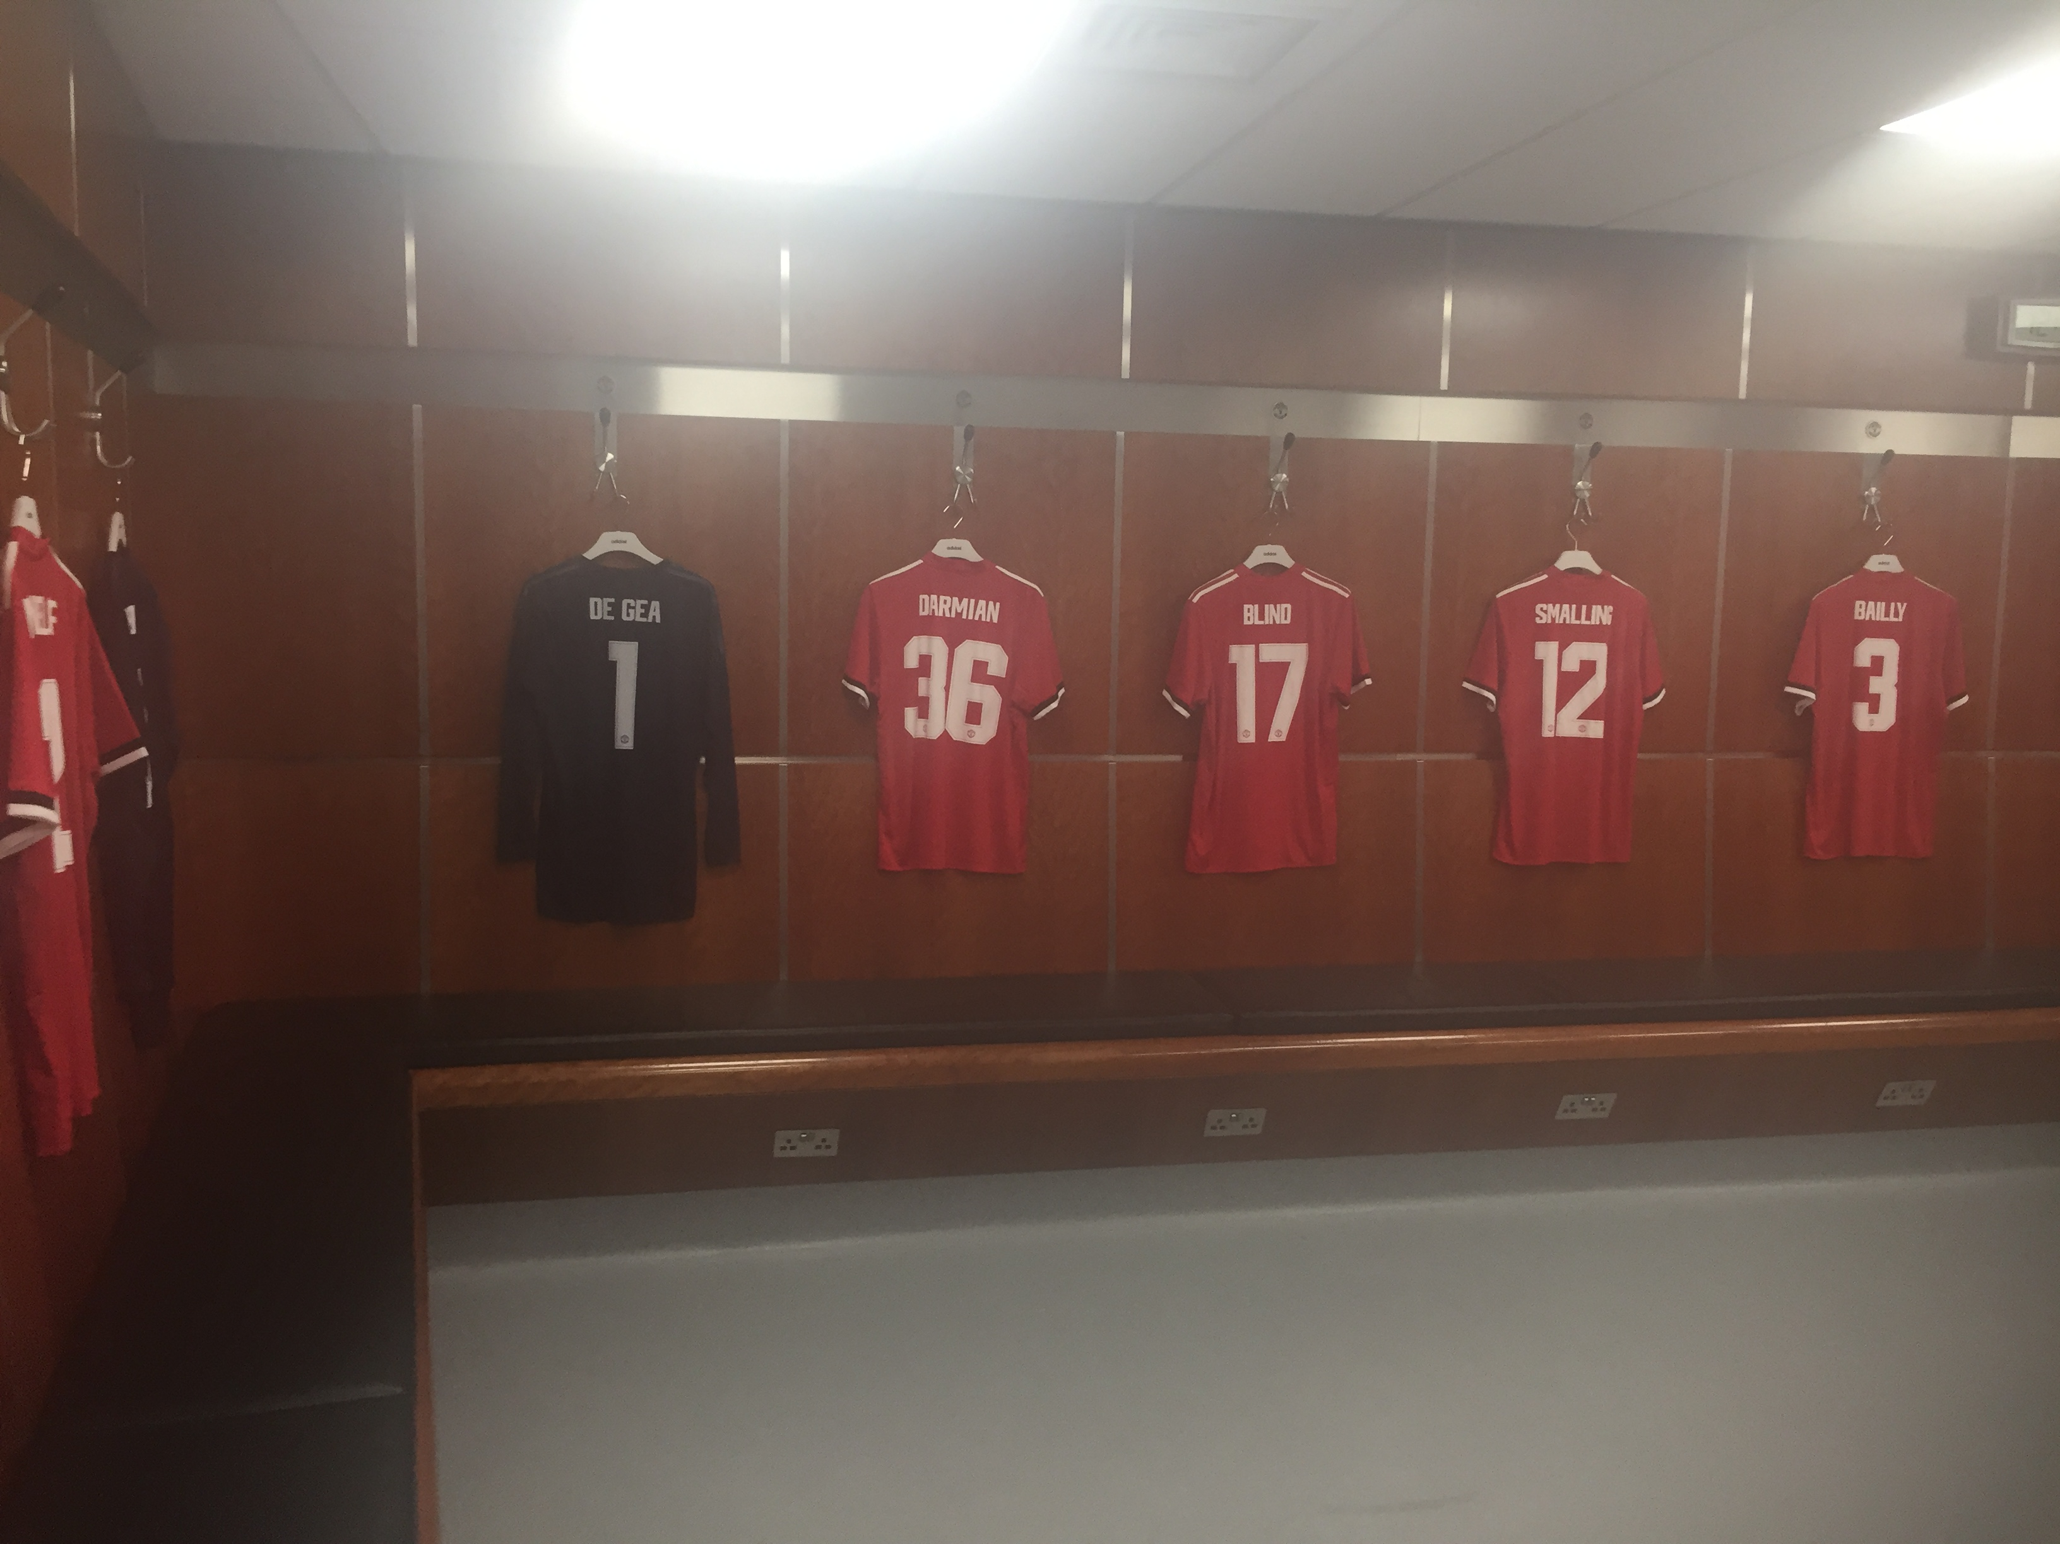
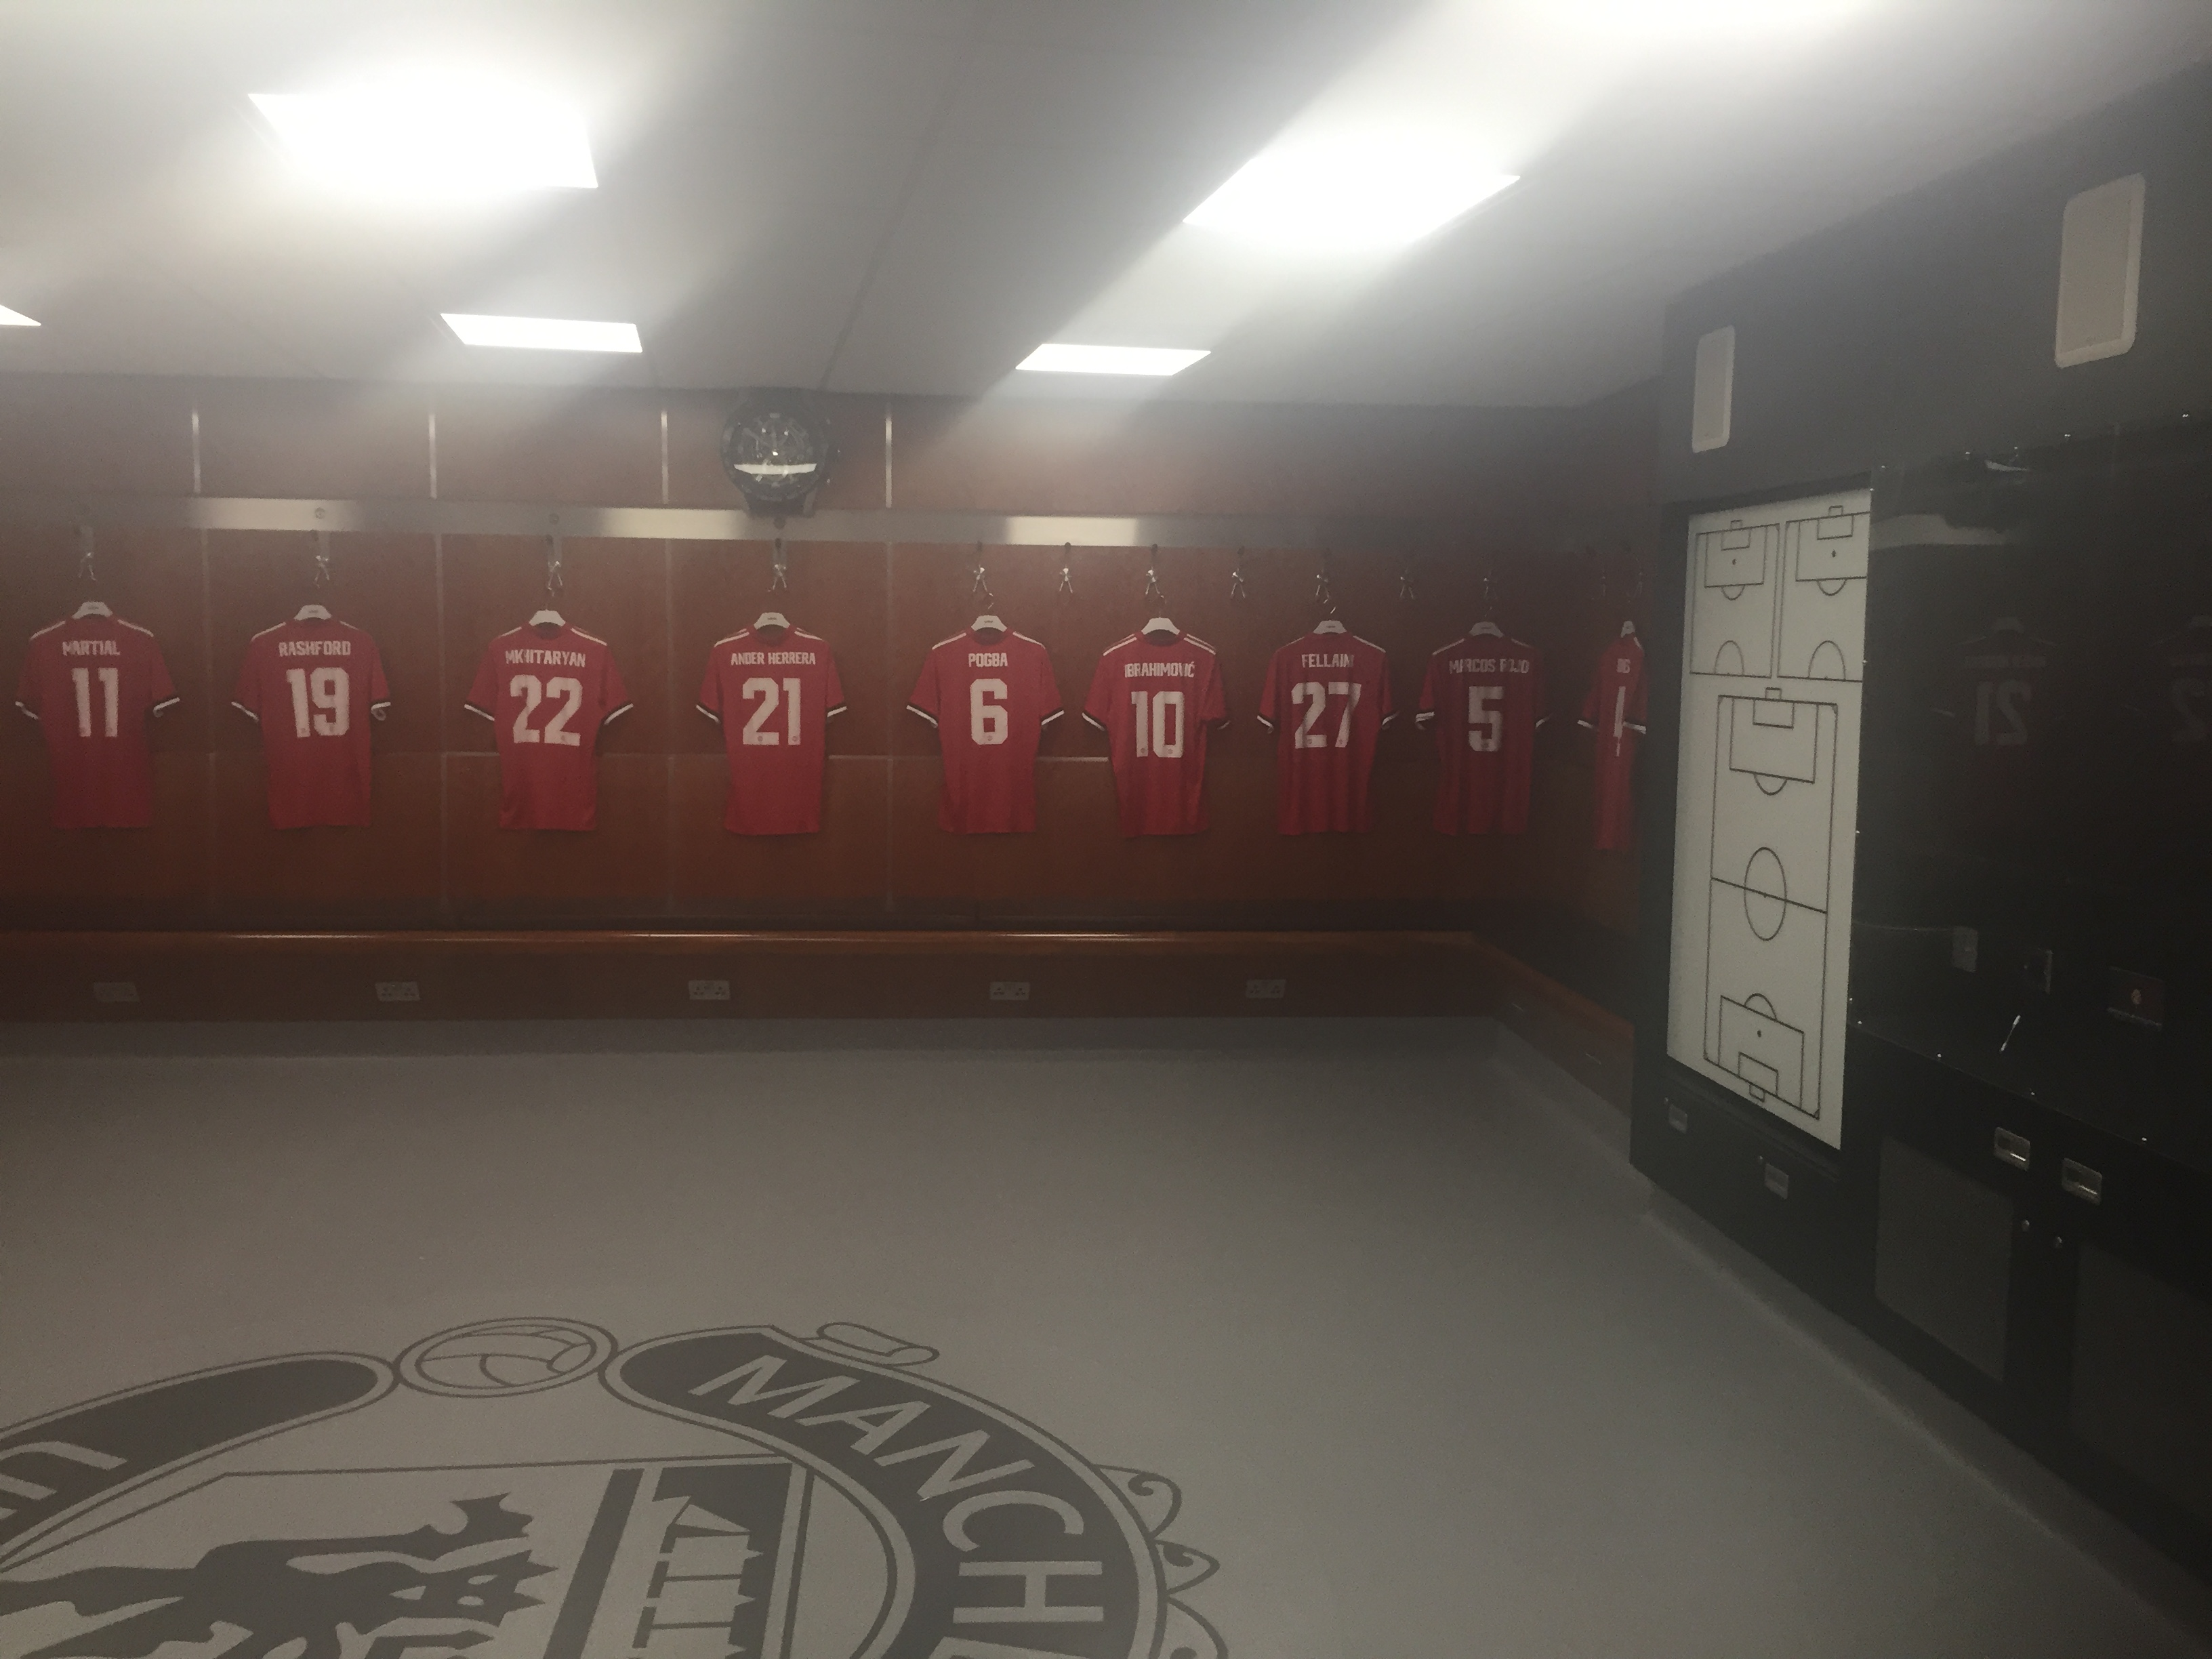
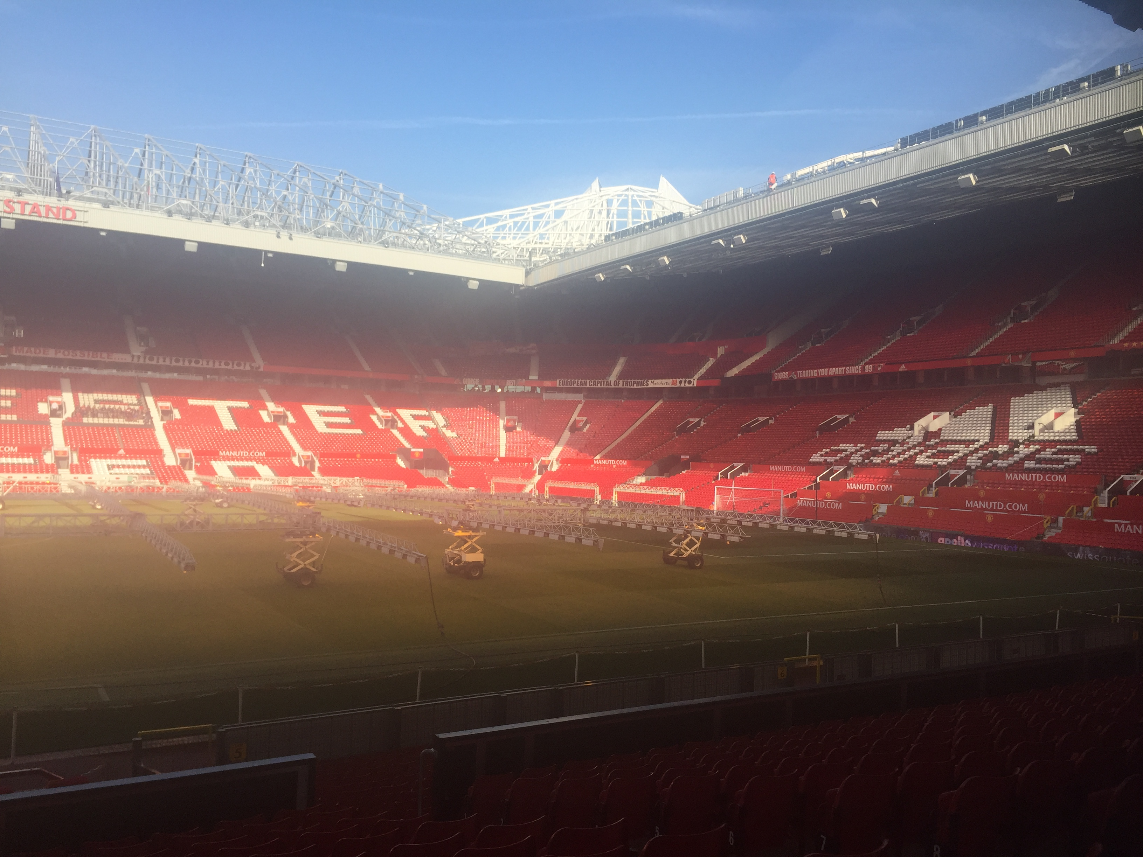
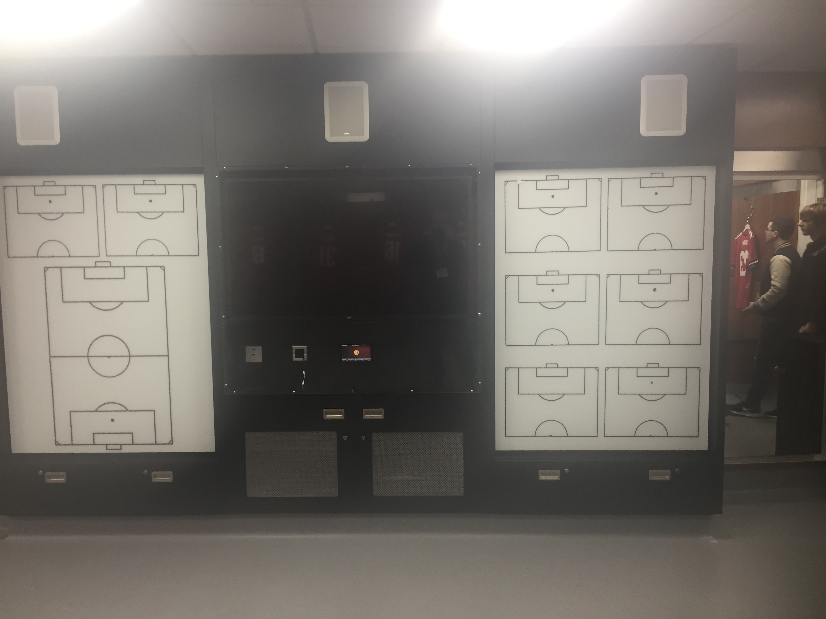
Pictures of Manchester Stadium

